Slide 1
Statistics with R - A beginner’s Perspective
Njoki Njuki Lucy,
MSc Statistics & Data Science (Biostatistics) student at Hasselt University
September 24, 2021

Slide 2
Acknowledge
Professor Roel Brakers, my lecture
Dr. Susan Wanja, Biostatistician
John Mutiso, Statistician at Phastar

Slide 3
About me
A second-year student at Hasselt University, pursuing MSc Statistics and Data Science specialising in Biostatistics (DL programme).
Previously worked as Intern Statistician at Nairobi Advent Foundation on a project to assess how the young adults in Kenya persive corruption in Kenya.
I am the organiser of R-Ladies Nairobi (part of the R-Ladies Global), whose mission is to promote gender diversity in the R community in Nairobi and Kenya at large.
I also love reading books, blogs about advances in scientific research. Currently part of a book club under R4DS community studying the “R for Data Science” book.

Slide 4
Overview
Learn about how and why statistics are used
Brief history about statistics
Basic statistics concepts
  Distributions
  Probability
Data basics: observations, variables
Become familiar with the normal distribution
Understand how statistical tests work

Slide 5
What is Statistics and why are Statistics used?
Statistics is a branch of science that deals with collection, organization, analysis, interpretation and presentation of data.
  What do we do with data collected?
    Collect, summarise, describe and explore the data.
Types of Statistics:
  Descriptive statistics:
    Involves analysing and interpreting the data.
    Drawing conclusions from a subset of data.
  Inferential statistics:
    Using data to make a conclusion about a population parameter using unbiased sample estimated.

Slide 6
Brief history about statistics
Originated from the Italian word “stato” (=states). Persons working for the states was a statistica.
But the origin is much older since long states and rulers used statistics to collect data about their people e.g., taxes.
Evident seen from the ancient writings.
We see that data has uncertainty and variation.
  For example: a new drug reduces hypertension by 85% while the older drug reduced by 80%.
Hence, methods of probability and statistics were developed to cater for this variation.

Slide 7
Definition of terms used in statistics
Population: All individuals with a specific characteristics of a variable of interest.
Sample: Subset of a population.
Parameter: numerical description of a population characteristic.
Statistic: numerical description of a sample characteristic.
Experimental unit/observation: an individual subject or object of a population.
Variable: a characteristic of a population.
Population
Sample

Slide 8
The Role of Probability
The origin of probability was gambling. In 16th and 17th centuries, professional gamblers asked some mathematicians such as Pascal to study gambling.
Around 1750, concepts of probability were used in states affairs e.g., lifetables.
Given the variability in the scientific data, we use probability to express how likely an outcome of a sample is from population is.
  E.g., During the world cup of soccer 2010 in SA, a German Octopus Paul, predicted correctly the outcomes of 7 German matches, and the final match between Holland and Spain.
Qn: How do probability and statistical inference work together?
  A sample selected from a population must be representative for this population.
    We use different sampling techniques such as Simple Random Sampling (no criteria is used to sample the subjects from a population).

Slide 9
Let’s talk about Variables
Quantitative
Variables can be measured, counted
Continuous
Intervals
Ratio(true zero)
e.g., temperature
Discrete
Takes only whole number count e.g., no. of pregnancies of a woman
Qualitative
Outcome of these variables can only be classified.
Nominal
Unordered groups e.g., gender
Ordinal
Ordered groups e.g., t-shirt sizes

Slide 10
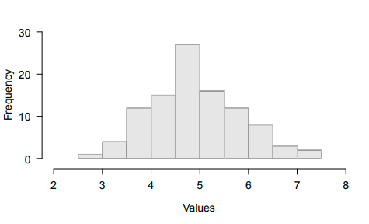
Distributions
Refers to how often different values occur in a set of data.
A common representation of a distribution: a histogram
  the horizontal x- axis-> values occurring in the data, separated by groups (i.e., columns)
  The vertical y-axis-> how many values fall into each group.
Histogram of normally distributed data

Slide 11
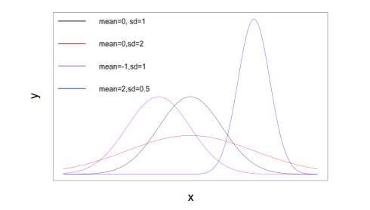
Normal Distribution(aka Bell Curve)
Described by Gauss and others in the early 19th century.
Provides the basis for many statistical analyses in use today.
Parameters:
  Mean which correspond to the center of the distribution.
  Standard Deviation refers to the spread of the distribution.
Data is symmetric around the mean.

Slide 12
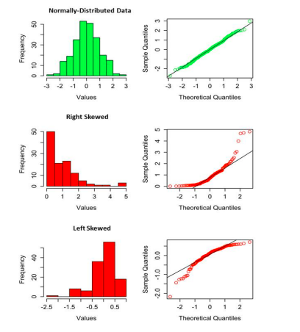
Normal Distribution(aka Bell Curve) Cont.
Qn: How do we assess normality?
  We must check if the given sample comes from a normal distribution.
    Construct a histogram or a stem-and-leaf plot.
      Normality is satisfied if the curve is similar to a normal curve.
    Construct a normal plot: Scatter plot of the ordered data values VS their expected values under normality.
      Normality is satisfied if the ordered data values lie on a straight line
      In R, qqnorm(mpg); qqline(mpg)

Slide 13
How to deal with data that is not normally distributed
Suppose, data is not normally distributed especially in size measurements where there could be many small measurement values and fewer larger values.
  SD and mean are not good measures of center and dispersion.
  Median and quartiles are better descriptive statistics:
    the median indeed is in the center of the data and,
    the quartiles nicely reflect the asymmetry in the distribution,
      i.e. , the distance between 25% quartile and median is smaller than the distance between 75% quartile and the median
  Use data transformation and calculate mean and standard deviation from transformed data.

Slide 14
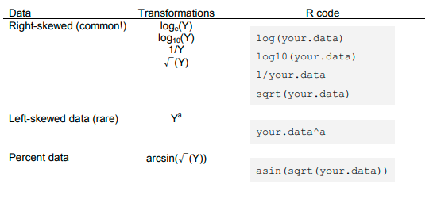

Slide 15
Descriptive Statistics
Aim-> summarise a data set.
3 different measures:
  Location measures: locate the center of the data.
  Variability measure: represent the spread of data around the center.
  Measures of relative standing: Gives the relative position of the observation.
Location measures:
  Sample Mean: point of balance
    In R; mean(x)
  Sample Median: divides the observations into two equal parts (<median, >median).
    In R; median(x)
  Mode: Value x that appears the most (i.e., highest frequency)
    Not often used as a measure of location because for discrete case, there maybe a lot unlike for a continuous, where it would be difficult to find common values.

Slide 16
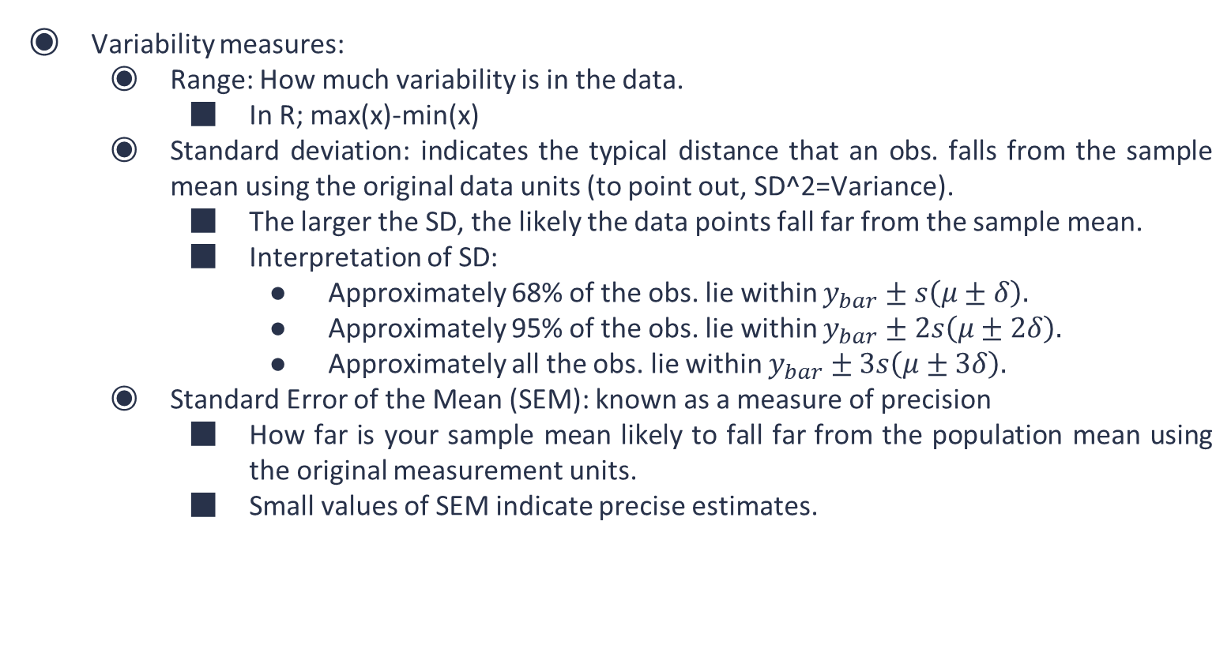
Descriptive Statistics Cont.
Variability measures:
  Range: How much variability is in the data.
    In R; max(x)-min(x)
  Standard deviation: indicates the typical distance that an obs. falls from the sample mean using the original data units (to point out, SD^2=Variance).
    The larger the SD, the likely the data points fall far from the sample mean.
    Interpretation of SD:
      Approximately 68% of the obs. lie within $y_{bar}±s\left(μ±δ\right).$
      Approximately 95% of the obs. lie within $y_{bar}±2s\left(μ±2δ\right).$
      Approximately all the obs. lie within $y_{bar}±3s\left(μ±3δ\right).$
  Standard Error of the Mean (SEM): known as a measure of precision
    How far is your sample mean likely to fall far from the population mean using the original measurement units.
    Small values of SEM indicate precise estimates.

Slide 17
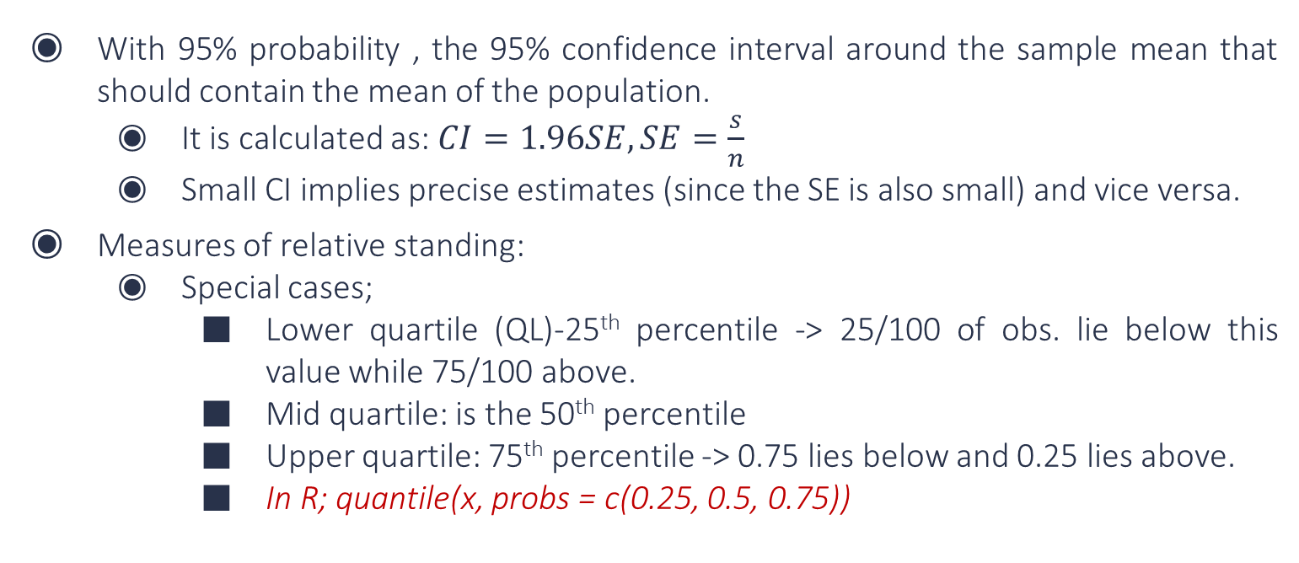
Descriptive Statistics Cont.
With 95% probability , the 95% confidence interval around the sample mean that should contain the mean of the population.
  It is calculated as:$CI=1.96SE, SE=\frac{s}{n}$
  Small CI implies precise estimates (since the SE is also small) and vice versa.
Measures of relative standing:
  Special cases;
    Lower quartile (QL)-25th percentile -> 25/100 of obs. lie below this value while 75/100 above.
    Mid quartile: is the 50th percentile
    Upper quartile: 75th percentile -> 0.75 lies below and 0.25 lies above.
    In R; quantile(x, probs = c(0.25, 0.5, 0.75))

Slide 18
Graphical Presentation
Frequency tables:
  Used for a qualitative variable.
  Count per qualitative variable.
    In R; table()
Stem-and-leaf plot:
  Quantitative variable
    Divide each obs. In a stem and a leaf e.g., 31.8; 31 8
    Order the stems in a column
    Place the leaf of each obs in the appropriate stem row
      In R; stem(mpg, scale = 2) * scale controls the length of the plot

Slide 19
Graphical Presentation Cont.
Histograms:
  Calculate the range
  Divide the rage into 5 till 20 classes -> select a class width.
  Count the no. of the obs. In each class -> class frequency
  Get the relative class frequency = class freq./total freq.
  Construct a histogram
  In R; hist(x, breaks = *)
Interquartile range : IQL= QU-QL
  Using a boxplot, we can jointly show the following summaries:
    Median, the lower quartile, the upper quartile, largest obs (upper whisker), smallest obs (lower whisker)
    Adding mean to a boxplot, we aim to see if the data is symmetric.
    In R; boxplot(x)

Slide 20
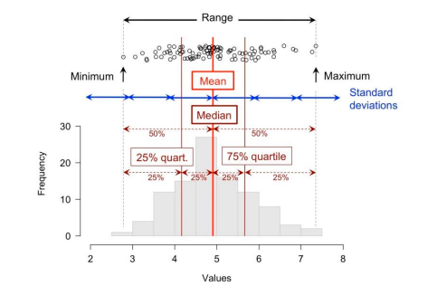
Graphical Presentation Cont.
Histogram of a normal distribution:
  mean
  median
  quartiles
  standard deviation

Slide 21
Statistical Inference
These are methods by which one can make inferences/generalizations about a population.
Two methods exist (just to mention):
  Classical/Frequentist method
  Bayesian method
Statistical Inference is divided into two:
  Estimation-> Based on a sample, estimate a certain population parameter
    Such as sample mean of men diseased with oesophagus cancer in Nairobi county
  Test of Hypothesis-> make a statement about a parameter (point estimator), test it using a test statistic, and make a conclusion.

Slide 22
How statistical tests work
H0: mean dispersal distance does NOT differ between male and female butterflies
HA: mean dispersal distance differs between male and female butterflies
  Two-sided hypotheses followed by a two-tailed test.
    By saying that dispersal distance differs, we imply that female dispersal distance could be either higher or lower than male dispersal distance.
Suppose, the null hypothesis is one-sided then we have:
  H0: mean dispersal distance does NOT differ between male and female butterflies
  HA: mean dispersal distance differs between male and female butterflies
    We hypothesise that the female butterflies differ from the male butterflies in a specific direction.
  Followed by a one-tailed test

Slide 23
How statistical tests work
Therefore, we calculate a test statistic from data to find out how likely the obtained result would be under the null hypothesis.
This leads to the probability under null hypothesis called p-value to help us make a decision rule about the hypotheses.
  P-value-> the probability of observing data values of the test statistic that at least as contradictory to the null hypothesis as the observed ones under the null hypothesis.
Common statistical tests usually have an outcome of "significant", meaning that the reject the null hypothesis is rejected (alternative hypothesis is accepted),
Or "not significant", meaning that the null hypothesis is failed to reject (the alternative hypothesis is discarded).
Notes:
P-values-as extreme as the observed values under ho

Slide 24
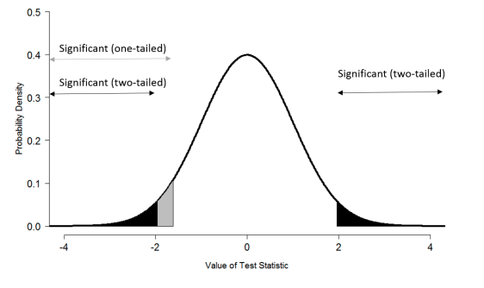
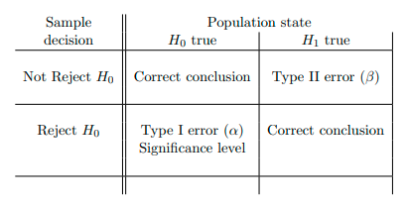
How is this decision made?
Decide based on the sample:
  At significance level α, reject H0 if p-value < α.
  Or, at significance level α, fail to reject H0 if p-value > α
Always, make a conclusion that is translated from a mathematical form to plain English following your research questions at hand!
Possible outcomes of statistical tests at the significance level, α.
Illustration of significance (P< 0.05) ranges in one- and two-tailed tests

Slide 25
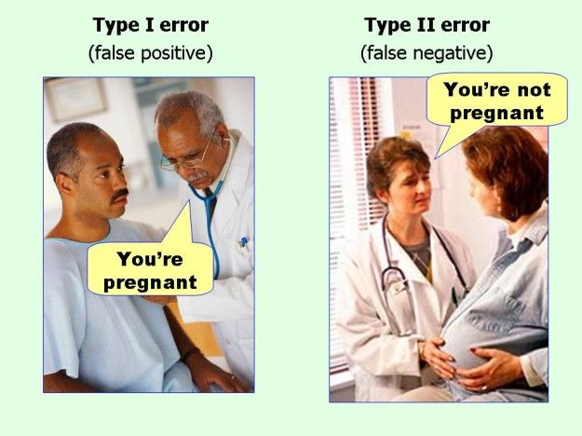
How is this decision made ?
Type I errors (false positives) i.e., the probability of failing to reject the null hypothesis when it is true.
  AKA significance level
  Commonly set to 0.05 or 0.01 in studies such as biological and clinical trail.
In statistical testing, decreasing type I error, then we increase type II error and vice versa.

Slide 26
References
R for Data Science: https://r4ds.had.co.nz/index.html
Blog post: Statistics by Jim: https://statisticsbyjim.com/hypothesis-testing/standard-error-mean/
Statistics with R — a practical guide for beginners, Uppsala University Fall 2014
Statistics With R Solving Problems Using Real-World Data, Jenine K. Harris

Slide 27
Thank You!
My social media handles:
Twitter: @lucy_njokinjuki
LinkedIn: https://www.linkedin.com/in/lucy-njoki/
GitHub: https://github.com/LucyNjoki
Gmail: lucynjokinjuki@gmail.com

